Slide 1
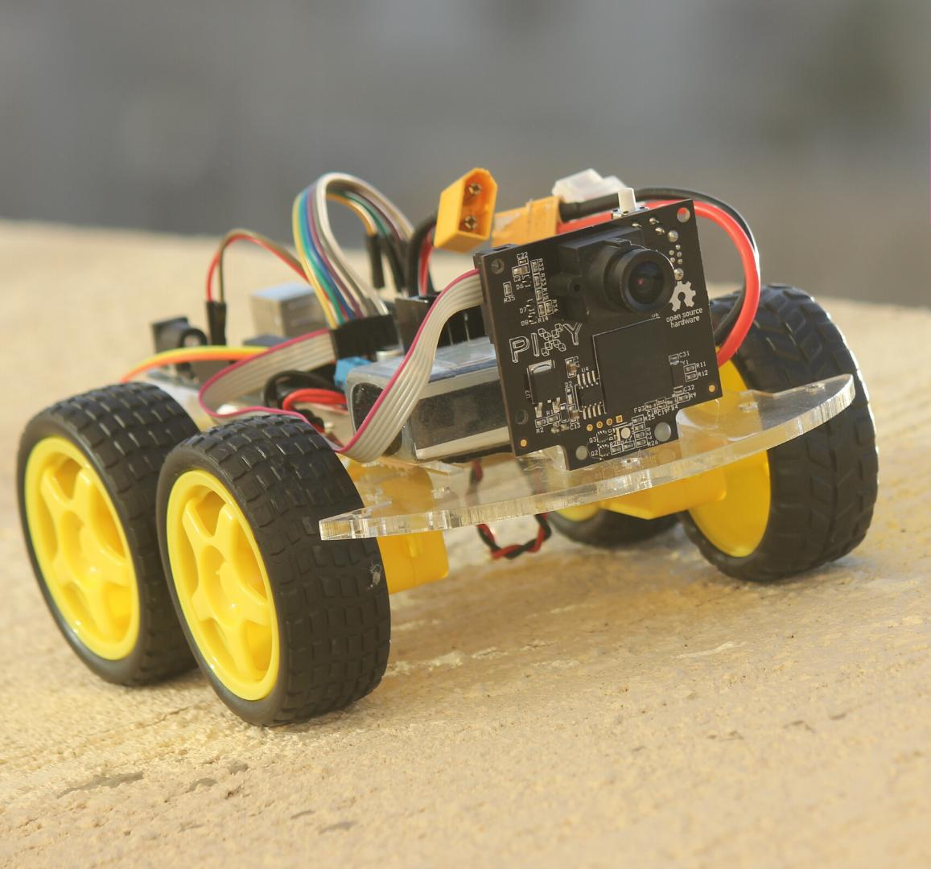
Following back-pack
A Robotic back-pack that follows you

Slide 2
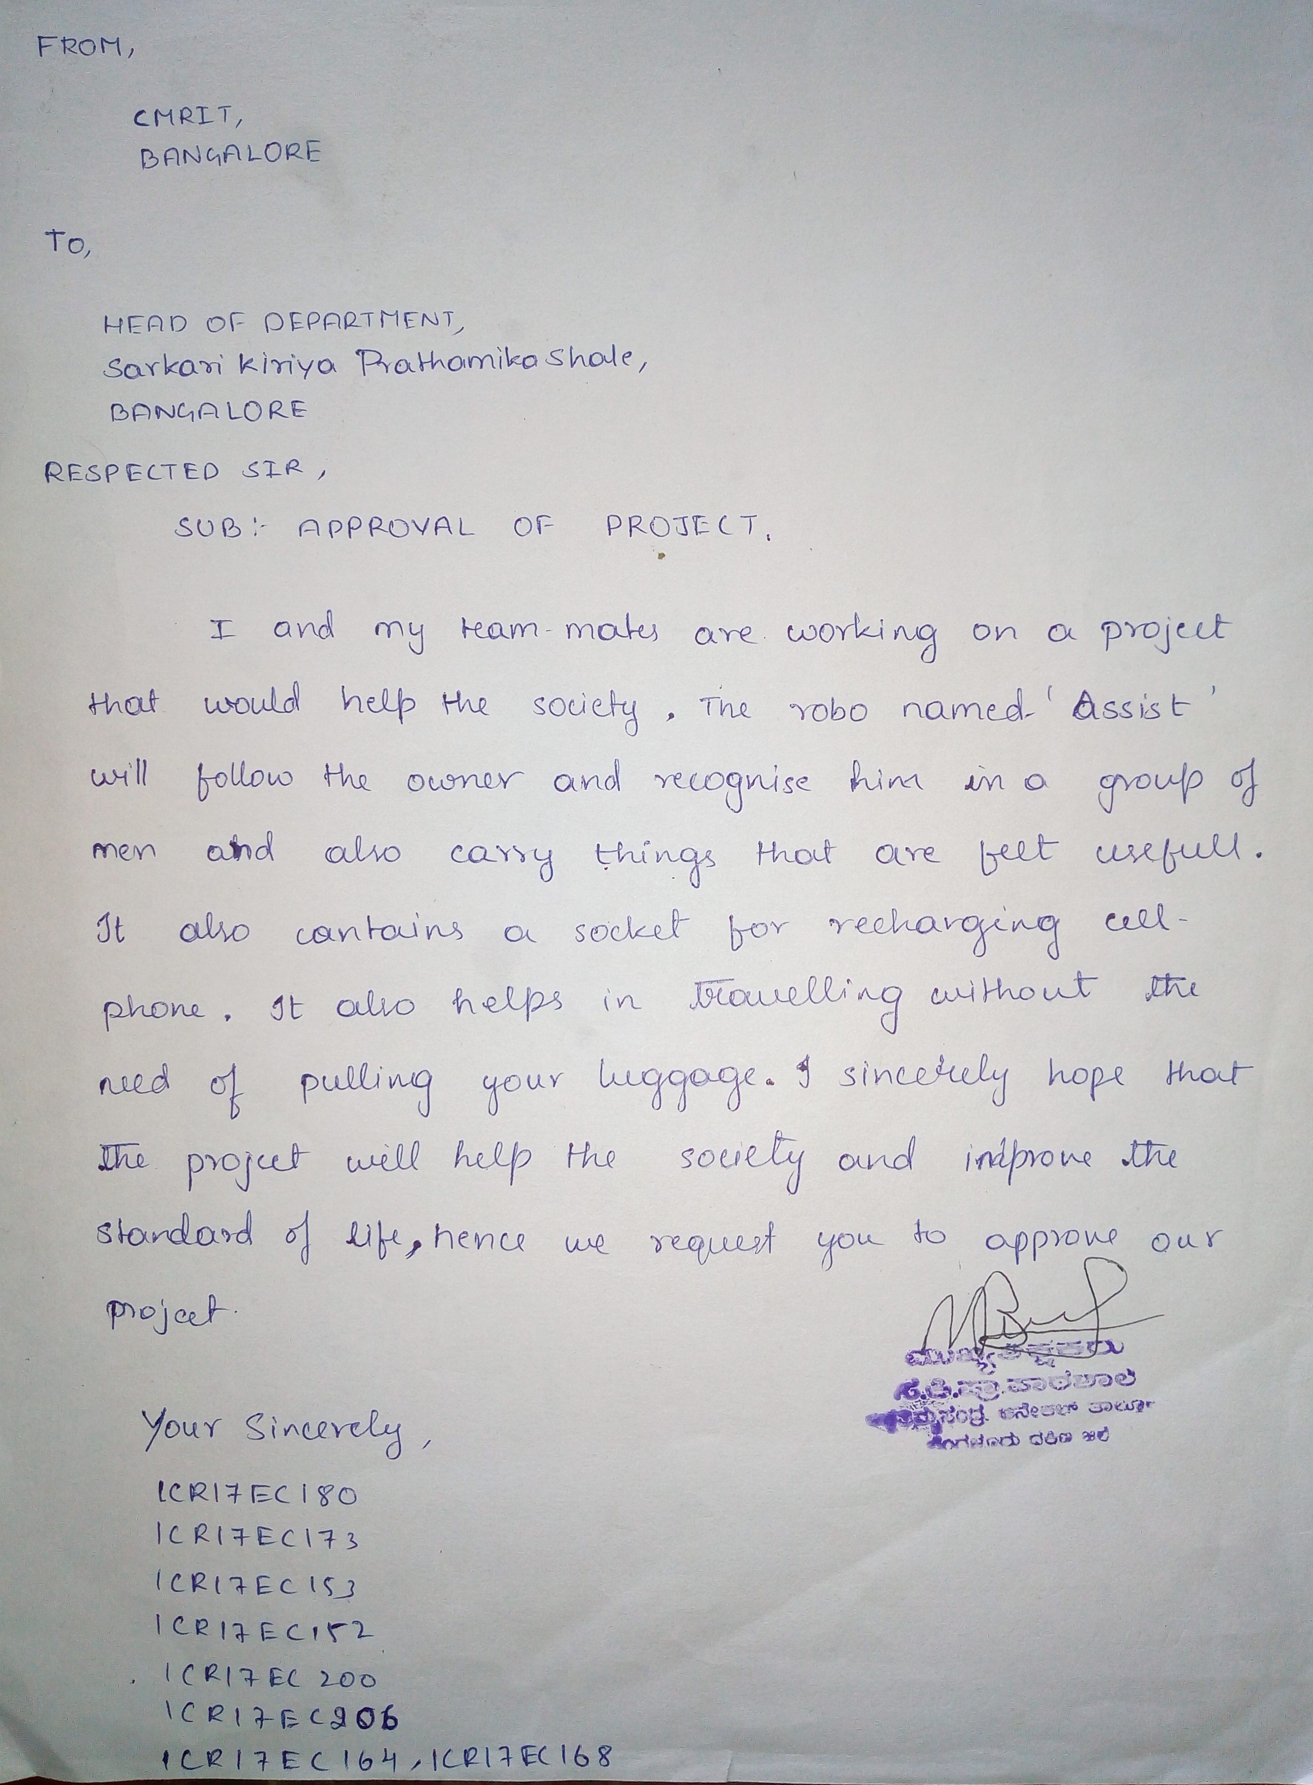
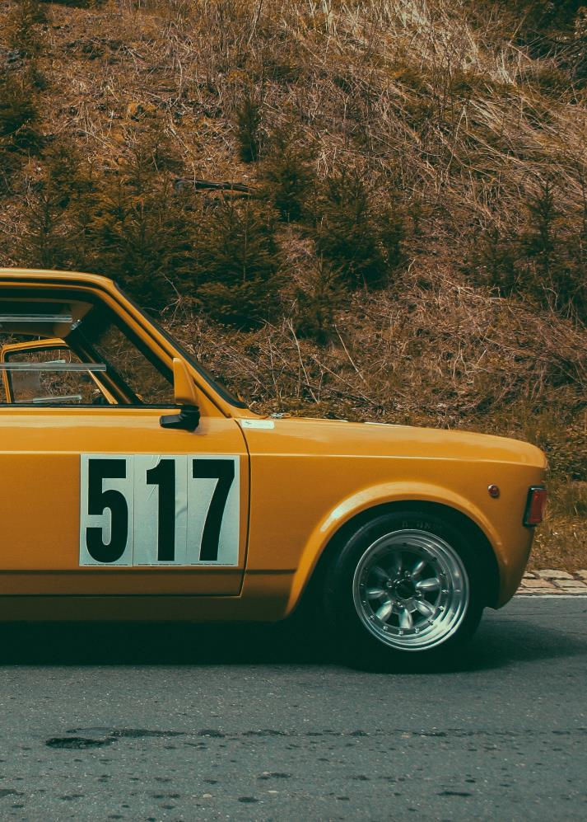
Approval letter
.
Approved From:
Head of Department
Sarkari Kiriya Prathamika Shala
Bangalore

Slide 3
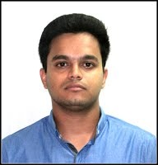
Project Mentor
Mrinal Jyoti Sharma
Mrinal Jyoti Sharma
B.Tech, M.E.
Electronics and Communication Engineering
B.Tech, M.E.
Electronics and Communication Engineering

Slide 4
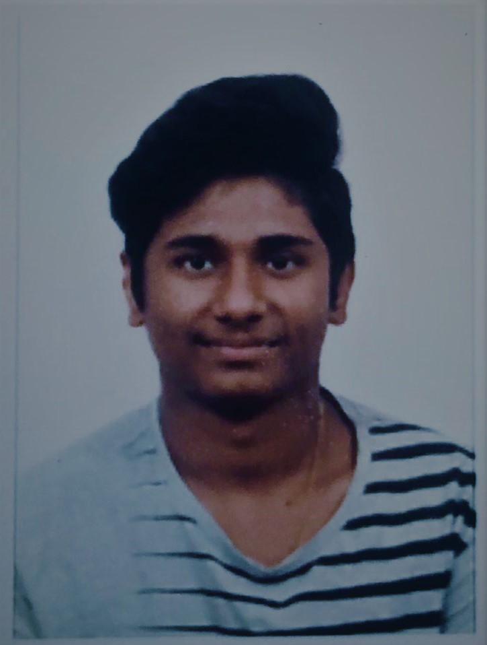




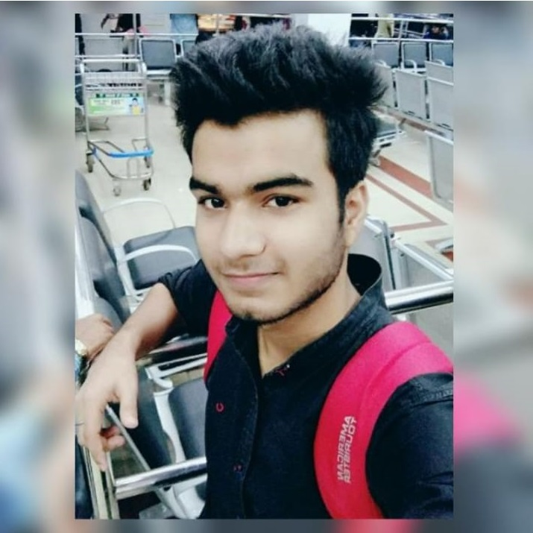
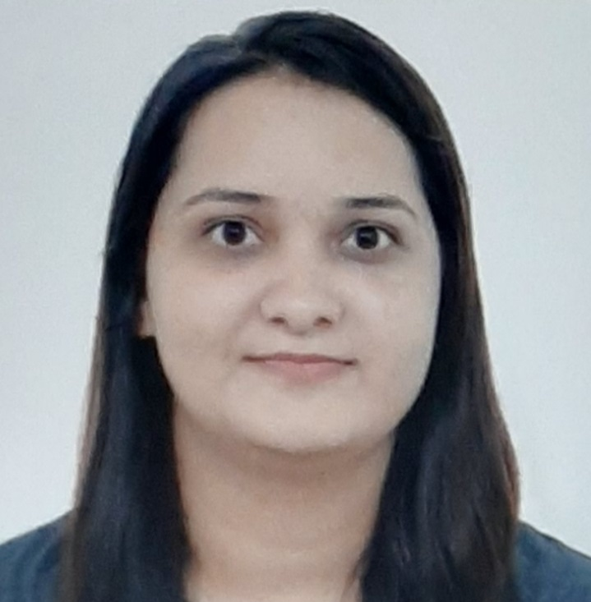

Team
T. Rohan Chaitanya Reddy
Rakshith V
Shamiran Behera
Sachin k Rao
Sahil Virdhi
Sangam Mishra
Tripti Kumari
Raju Kumar

Slide 5
Acknowledgement
I have taken efforts in this project. However, it would not have been possible without the kind support and help of many individuals. I would like to extend my sincere thanks to all of them.
I am highly indebted to our project mentor for their guidance and constant supervision as well as for providing necessary information regarding the project & also for their support in completing the project.
My thanks and appreciations also go to my team in developing the project and people who have willingly helped me out with their abilities
I would like to express my gratitude towards my parents for their kind co-operation and encouragement which help me in completion of this project.

Slide 6
Description
In today’s era robots play a very important role.
Robots are used to perform various task which are dangerous for human beings in certain cases.
Robot assistance is proved to be always helpful for us.
A robot that can carry our stuff and accompany us in shopping malls, home, golf courses.
There are many advantages of having such kind of robots.
It can also be used in civil and industrial applications.
It is desired in many applications that the robot be able to track and follow the person.
The primary goal of our work was to design and fabricate a robot that not only tracks the target but also moves towards it while doing the tracking.
In order to make things simpler, a unique handmade tag was placed on the person that the robot needs to follow.

Slide 7
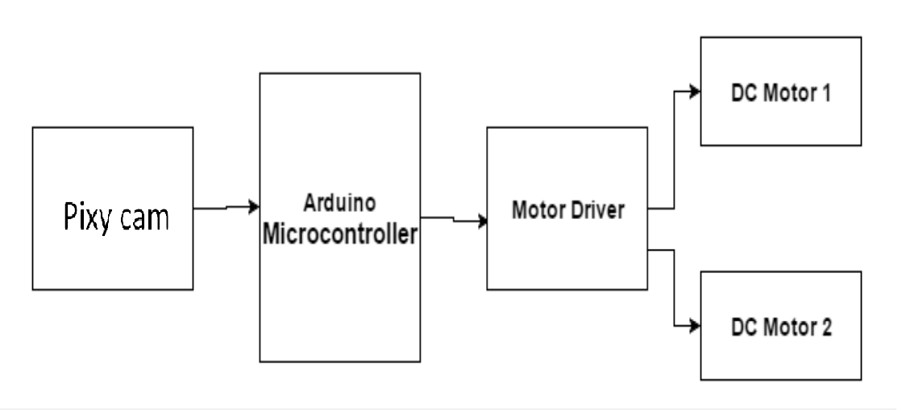
Block Diagram

Slide 8
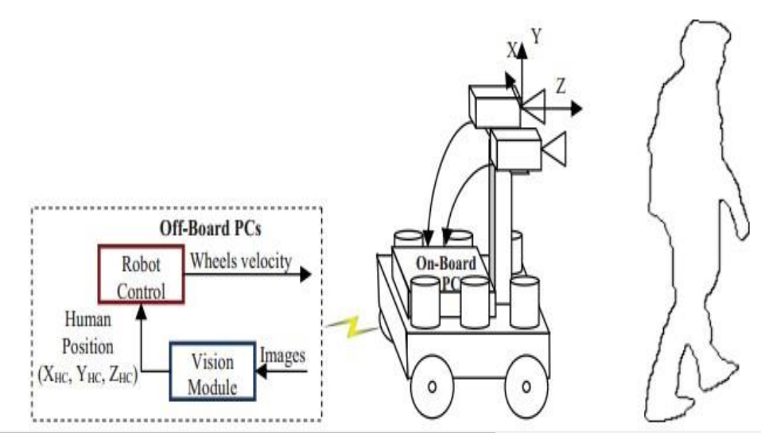
Human Following Robotic System.

Slide 9
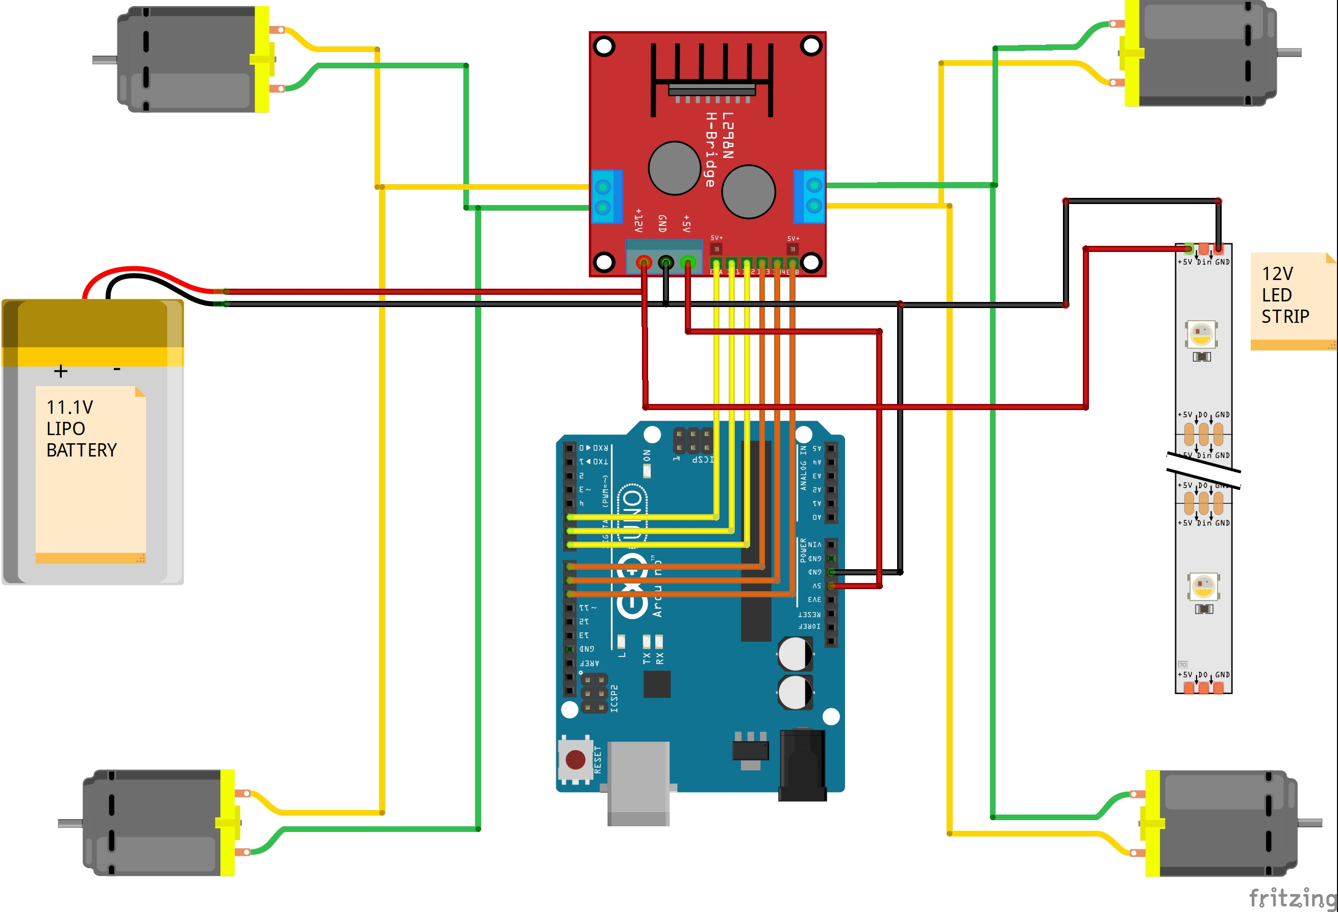
CIRCUITARY

Slide 10
Bills Of Material
DC MOTORS
WHEELS
CHASIS
ARDUINO UNO
MOTOR DRIVER
PIXY CAM
BATTERY
LED STRIP
SPI CABLE
JUMPERS
HARD CASE BAG

Slide 11
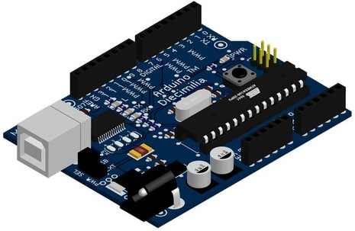
ARDUINO UNO
Arduino is an open-source electronics platform based on easy-to-use hardware and software.
Arduino boards are able to read inputs - light on a sensor, a finger on a button, or a Twitter message - and turn it into an output - activating a motor, turning on an LED, publishing something online.
You can tell your board what to do by sending a set of instructions to the microcontroller on the board.
To do so you use the Arduino programming language (based on Wiring), and the Arduino Software (IDE), based on Processing.
There are many other microcontrollers and microcontroller platforms available for physical computing.

Slide 12
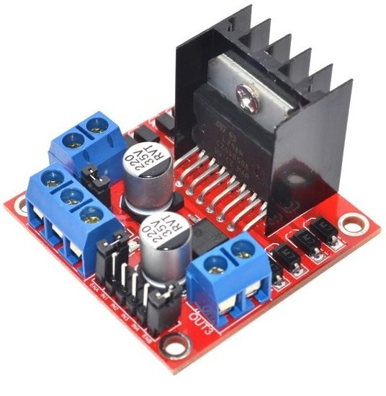
MOTOR DRIVER -L298
The L298N H-bridge module can be used with motors which have a voltage range of between 5 and 35V DC.
With the help of L298N H-bridge module, it is quite easy to control one or two DC motors. First, connect each motor to the A and B connections on the L298N module.
Ensure that the polarity of the motors is the same on both inputs if you are using two motors for a robot or anything.
Otherwise, you may need to exchange them over when both motors are set to forward and one goes backward.
Next, connect the power supply to pin number 4 on the L298N module and negative/GND to pin number 5 of the L298N module.

Slide 13
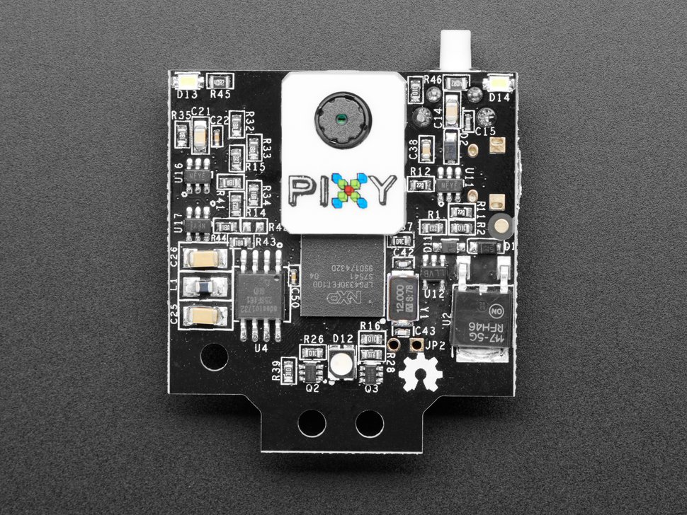
PIXY CAM
Pixy is described as a “visual sensor”.
It captures the visible range of the electromagnetic spectrum at 60 frames per second and can select wavelengths from within.
When a group of pixels is registered as being within range of the selected wavelength, it is represented as a box with dimensions and position x, y relative to the field of view.
These dimensions and positions can then be sent to: Arduino, computer, etc. for use in your favorite image mapping program.

Slide 14
Software requirements
Tool:
Arduino Ide
Open cv
Programming language:
C/C++

Slide 15
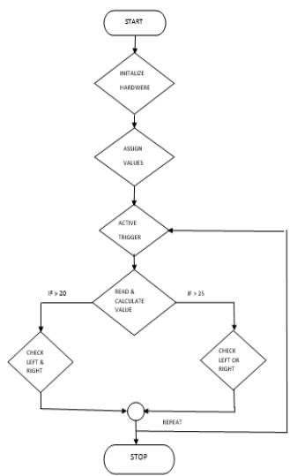
CODE FLOW

Slide 16
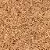
CODE:
#include <SPI.h> #include <Pixy.h> Pixy pixy; //////////////////////////////////////////////////////// // ENA IN1 IN2 IN3 IN4 ENB int myPins[6] = {5, 6, 7, 8, 9, 10}; float deadZone = 0.15; //int baseSpeed = 130; //////////////////////////////////////////////////////// int cont = 0; int signature, x, y, width, height; float cx, cy, area;

Slide 17
CODE:
void setup() { Serial.begin(9600); Serial.print("Starting...\n"); pixy.init(); for (int i = 0; i < 6; i++) { pinMode(myPins[i], OUTPUT); } }

Slide 18
CODE:
void loop() { float turn = pixyCheck(); if (turn > -deadZone && turn < deadZone) { turn = 0; } if (turn < 0) { moveRobot(-80, 170); } else if (turn > 0) { moveRobot(170, -80); } else { moveRobot(70, 70); } delay(1); }

Slide 19
float pixyCheck() { static int i = 0; int j; uint16_t blocks; char buf[32]; blocks = pixy.getBlocks(); if (blocks) { signature = pixy.blocks[0].signature; height = pixy.blocks[0].height; width = pixy.blocks[0].width; x = pixy.blocks[0].x; y = pixy.blocks[0].y; cx = (x + (width / 2)); cy = (y + (height / 2)); cx = mapfloat(cx, 0, 320, -1, 1); cy = mapfloat(cy, 0, 200, 1, -1); area = width * height; } else { cont += 1; if (cont == 100) { cont = 0; cx = 0; } } return cx; }
CODE:

Slide 20
CODE:
float mapfloat(long x, long in_min, long in_max, long out_min, long out_max) { return (float)(x - in_min) * (out_max - out_min) / (float)(in_max - in_min) + out_min; }

Slide 21
void moveRobot(int leftSpeed, int rightSpeed) { if (leftSpeed >= 0) { digitalWrite(myPins[1], 0); digitalWrite(myPins[2], 1); } else { digitalWrite(myPins[1], 1); digitalWrite(myPins[2], 0); } if (rightSpeed >= 0) { digitalWrite(myPins[3], 0); digitalWrite(myPins[4], 1); } else { digitalWrite(myPins[3], 1); digitalWrite(myPins[4], 0); } analogWrite(myPins[0], abs(leftSpeed)); analogWrite(myPins[5], abs(rightSpeed)); }
CODE:

Slide 22
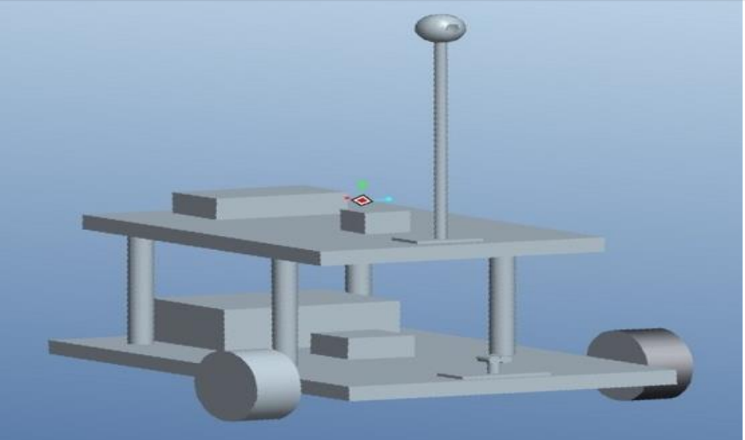
Isometric view (Mechanical Structure)

Slide 23

Advantages
Unique
First to Market
Useful for aged people.
Handicapped people can carry their luggage effortlessly.
Efficient
Authentic
Decreases human load carrying.
No need to carry. It follows only you.

Slide 24



Advantages
Assistance
Services
Can assist in carrying loads for people working in hospitals, libraries, airports
Can service people at shopping centers or public areas
Care
Defence
Can assist elderly people, special children and babies.
Can follow a particular Vehicle.

Slide 25

Future of this project
There are many interesting applications of this robot in different fields whether military or medical.
A wireless communication functionality can be added in the robot to make it more versatile and control it from a large distance.
This capability of a robot could also be used for military purposes.
By mounting a real time video recorder on top of the camera, we can monitor the surroundings by just sitting in our rooms.
We can also add some modifications in the Human Following Robot algorithm and the structure as well to fit it for any other purpose.
E-g a vehicle follower.
.

Slide 26

conclusion
A successful implementation of a person follower robot is illustrated in this presentation.
This robot does not only have the detection capability but also the tracking and following ability as well.
The tracking is basically performed on the tag and the human is followed on the basis of that detection.
It was also kept in mind that the „following‟ capability of the robot should be as efficient as possible.
The tests were performed on the different conditions to pin point the mistakes in the algorithm and correct them.
The different sensors that were integrated with the robot added an additional advantage.
.

Slide 27
THANK YOU
Choosing the right over the pleasant is the sign of power

